Slide 1
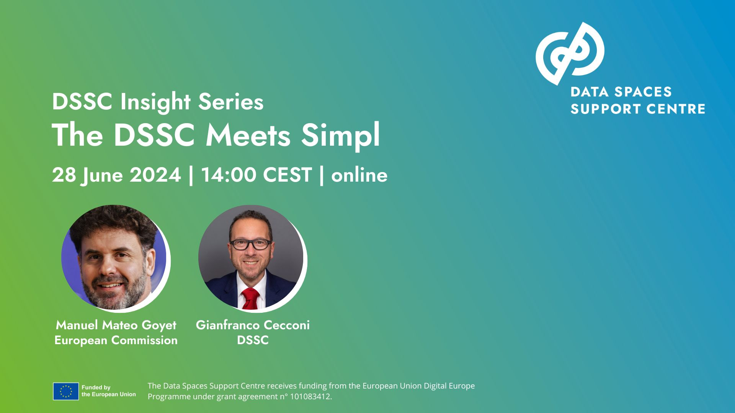
Notes:
Welcome to this month’s DSSC Insight Series, the monthly webinar appointment from the data spaces support centre.

Slide 2
Today’s Agenda
Introduction - Gianfranco Cecconi, Executive Director, Data Spaces Support Centre
Updates on Simpl - Manuel Mateo Goyet, Acting Head of Unit, European Commission
Updates since Darmstadt, current synergies and the road ahead -Gianfranco Cecconi, Manuel Mateo Goyet
Q&A (You can also ask questions in the chat!)

Slide 3
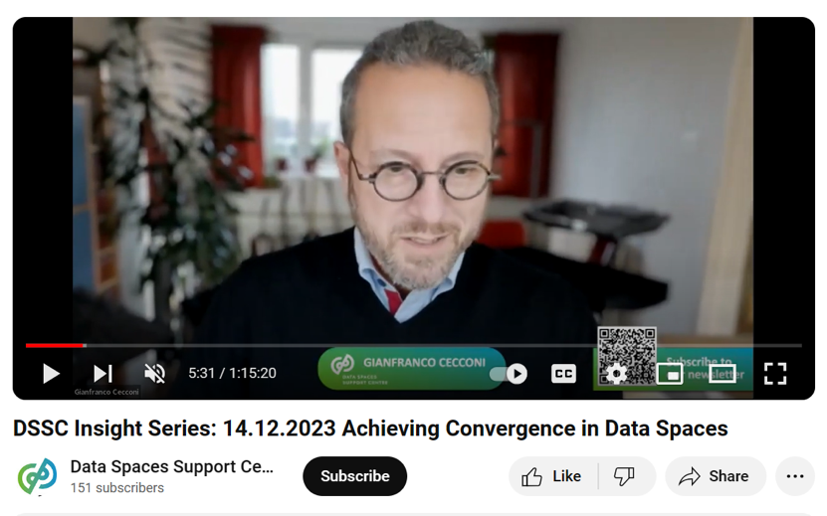
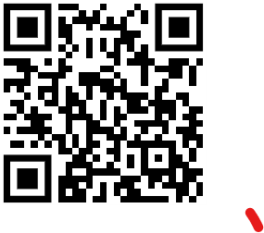
This webinar is recorded. Did you know? Previous DSSC insight series recordings are available on our Youtube channel. Videos from our annual event are also available!
Subscribe to our YouTube channel here

Slide 4
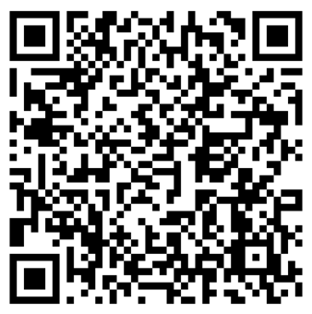
Stay up to date with Data Spaces Support Centre and the European Union’s programme for common European data spaces.
Subscribe to the DSSC Newsletter! tinyurl.com/dssc-newsletter

Slide 5


Image © Sony Pictures, “Jerry Maguire”, 1996
YOU… COMPLETE ME
Notes:
Article 17, part 7 of the Directive (EU) 2019/790 of the European Parliament and of the Council of 17 April 2019 on copyright and related rights in the Digital Single Market and amending Directives 96/9/EC and 2001/29/EC enables the use of copyrighted materials for “caricature, parody or pastiche”, as in memes like this.

Slide 6
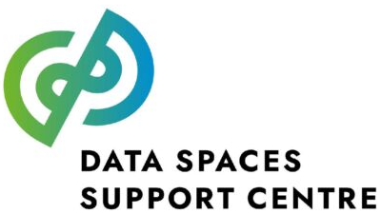
Data Spaces Support Centre’s activities and offerings
What DSSC does | We engage and create a community of EU-funded data space initiatives and other EU stakeholders… … but not only: we look outside and learn from other initiatives, like in the private sector. | The learning we acquired from the community, existing practices and standards are researched, structured and distilled into meaningful inputs for the following stages. | “Expert Groups”, and our own experts, facilitated by the team, combine our learning and co-create assets for the guidance of the Common European Data Spaces and more | We disseminate our assets so that the Common European Data Spaces – and everyone, really! – is informed of their availability and evolution. | We enable European data space to move from learning to doing, and support them in the process.
What DSSC offers | “Relationship management” and facilitation of a Community of Practice for the Common European Data Spaces Facilitation of a Network of Stakeholders | Review of pre-existing specifications and standards | The Glossary and Conceptual Model The Starter Kit The Blueprint as a specification of re-usable building blocks and components | Communications: the website, social media… Engagement of the public: webinars, the annual Symposium, participation to other relevant initiatives’ events… Engagement of Standard Development Organisations | The Co-Creation Method The Radar The Toolbox Our support Maturity modelling, impact monitoring and evaluation
Community building
Distillation
Synthesis
Dissemination
Guidance and support

Slide 7
Data Spaces Support Centre’s activities and offerings
What DSSC does | We engage and create a community of EU-funded data space initiatives and other EU stakeholders… … but not only: we look outside and learn from other initiatives, like in the private sector. | The learning we acquired from the community, existing practices and standards are researched, structured and distilled into meaningful inputs for the following stages. | “Expert Groups”, and our own experts, facilitated by the team, combine our learning and co-create assets for the guidance of the Common European Data Spaces and more | We disseminate our assets so that the Common European Data Spaces – and everyone, really! – is informed of their availability and evolution. | We enable European data space to move from learning to doing, and support them in the process.
What DSSC offers | “Relationship management” and facilitation of a Community of Practice for the Common European Data Spaces Facilitation of a Network of Stakeholders | Review of pre-existing specifications and standards | The Glossary and Conceptual Model The Starter Kit The Blueprint as a specification of re-usable building blocks and components | Communications: the website, social media… Engagement of the public: webinars, the annual Symposium, participation to other relevant initiatives’ events… Engagement of Standard Development Organisations | The Co-Creation Method The Radar The Toolbox Our support Maturity modelling, impact monitoring and evaluation
Community building
Distillation
Synthesis
Dissemination
Guidance and support

Slide 8
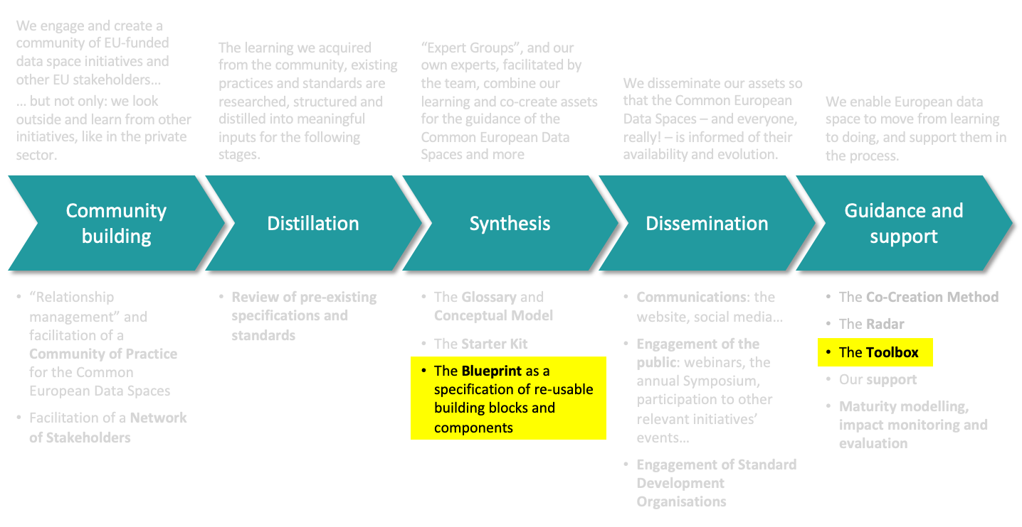
You… complete me
Implementations of business
and organisational building blocks
and components
Implementations of
technical building blocks
and components
Engineering’s True Connector
Eclipse
Data Space Components
TNO’s Security Gateway
Simpl
many others…

Slide 9
Simpl
Manuel Mateo Goyet – Acting Head of Unit – Cloud and Software unit - EC DG Connect

Slide 10






Simpl is the common software behind common data spaces
Industrial
data cloud
Common European Data Spaces are a federated data ecosystem based on shared policies and rules. The participants of data spaces are enabled to access data in a secure, transparent, trusted, easy and unified fashion.
Data holders remain in control of who can access and use their data, for which purpose and under which conditions.
SIMPL
Citizens
IoT
data cloud
SIMPL
SIMPL
SIMPL
SIMPL
SMEs
Industries
SIMPL
Open
data source
SIMPL
Research
SIMPL
SIMPL
Data
Intermediary
Public Org.
Data exchange
Metadata exchange

Slide 11
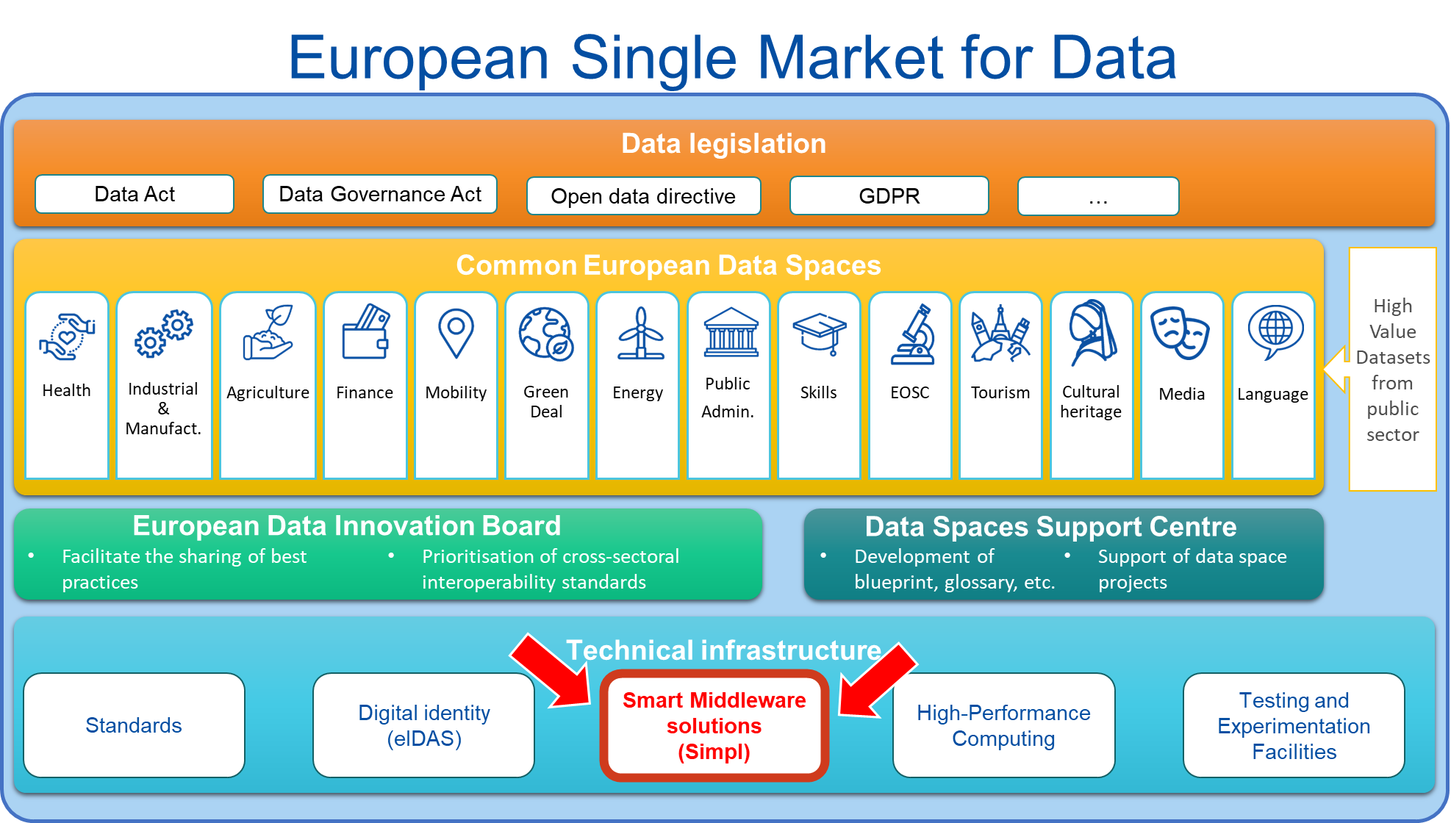

Slide 12
Simpl
middleware are software suites that enable applications and databases to work seamlessly together and provide a flawless user experience
open-source means built-in trust & security, flexibility to deploy, simplicity to customise
Simpl is the open-source smart middleware platform that enables cloud-to-edge federations and all major data initiatives funded by the European Commission
cloud-to-edge federations put together resources across cloud and edge computing environments as a cohesive system, creating a seamless integrated infrastructure that combines the strength of both cloud and edge computing.
all major data initiatives, in particular the development of Common European Data Spaces modular and interoperable way.

Slide 13
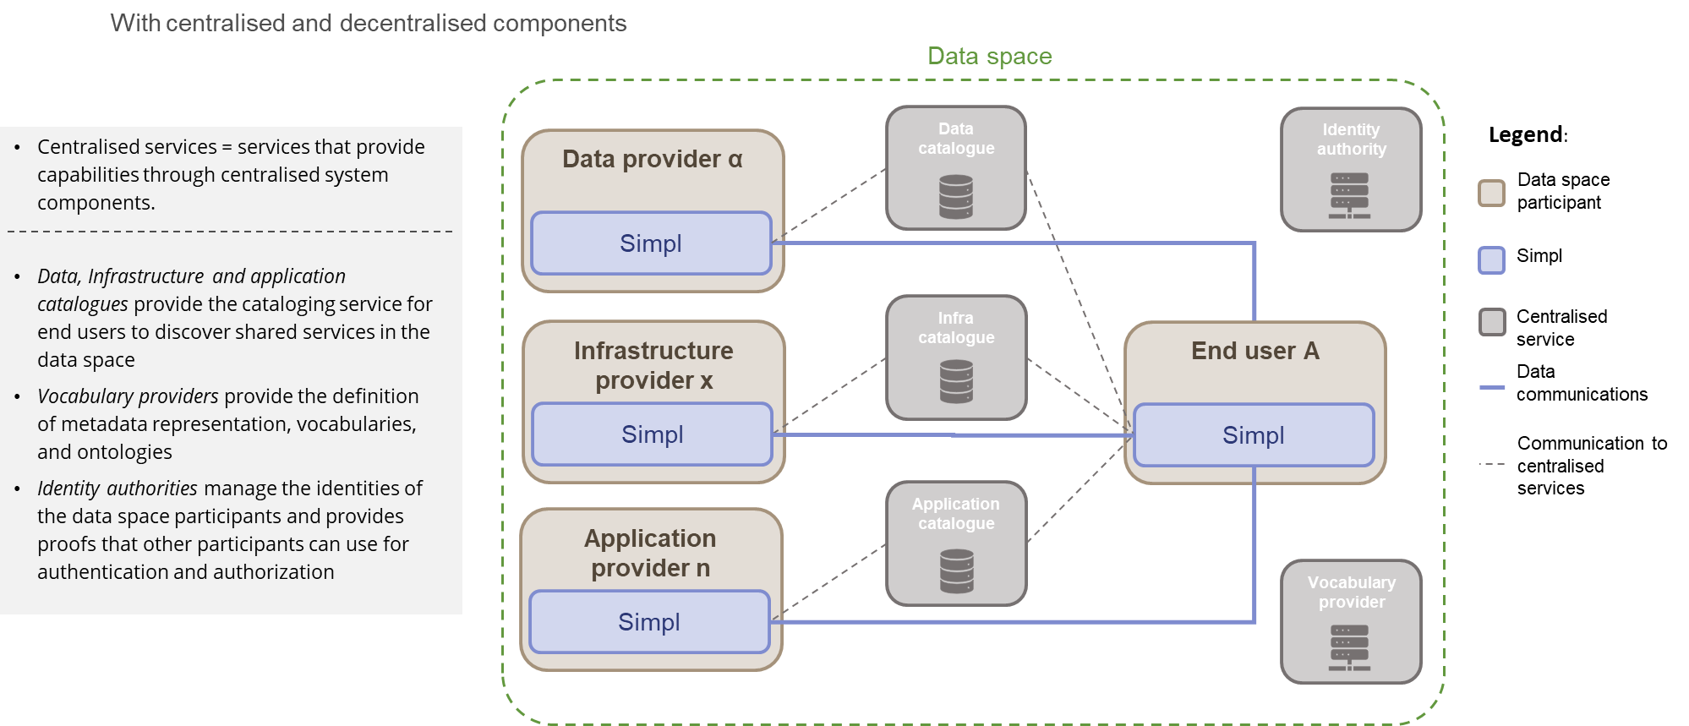
Simpl is deployed throughout data spaces

Slide 14

Simpl’s value proposal
No wheel re-invention
Interoperability
Save money
Save time

Slide 15
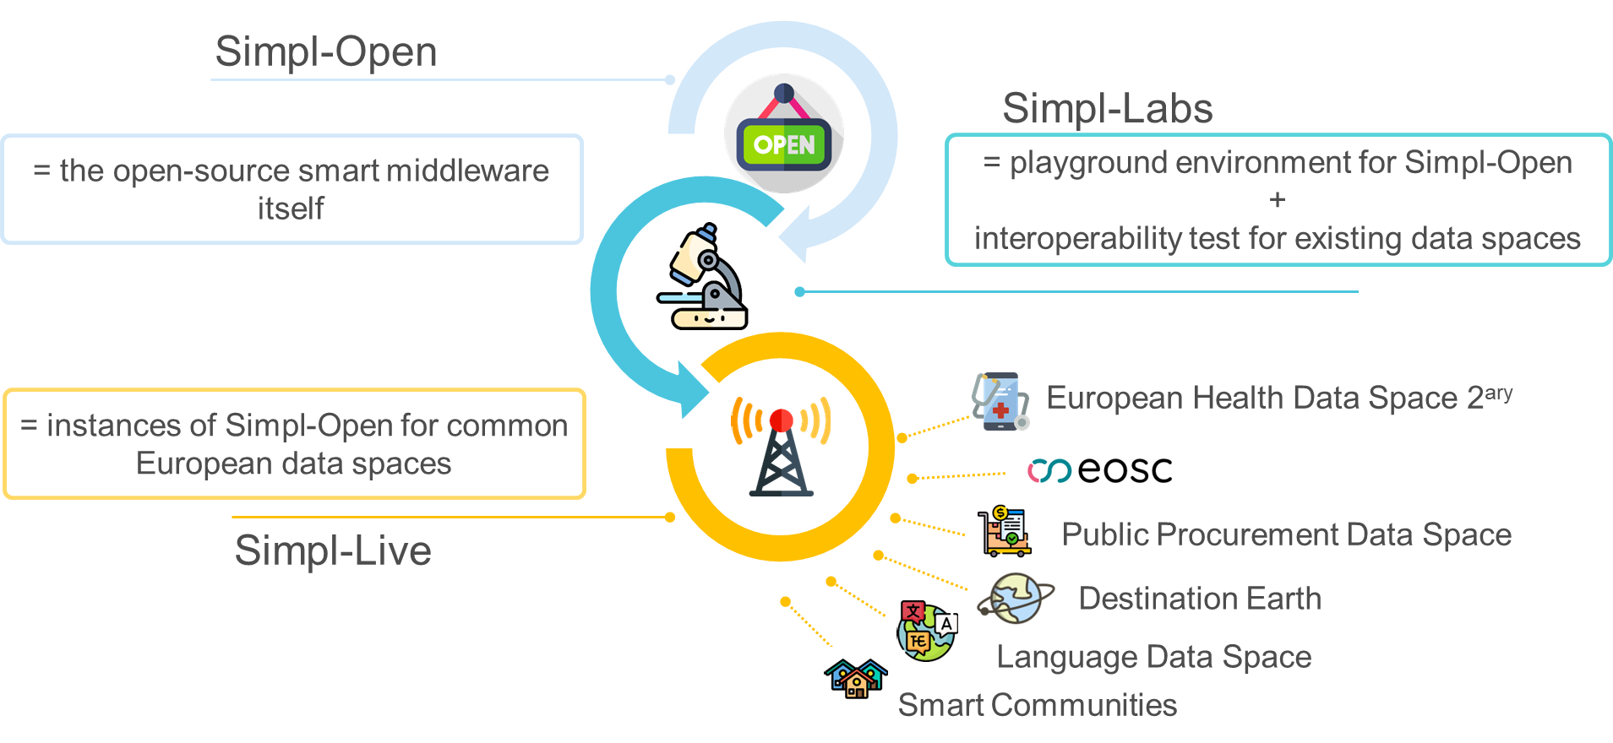
Simpl is made of three products

Slide 16









Contract awarded to
And

Slide 17

What are we working on today?

Slide 18
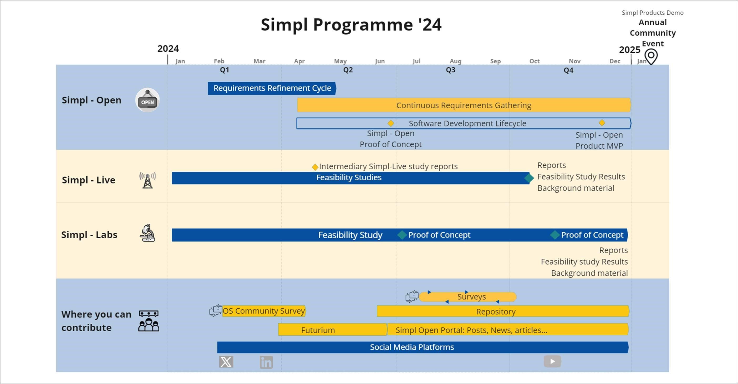
2024 timeline

Slide 19
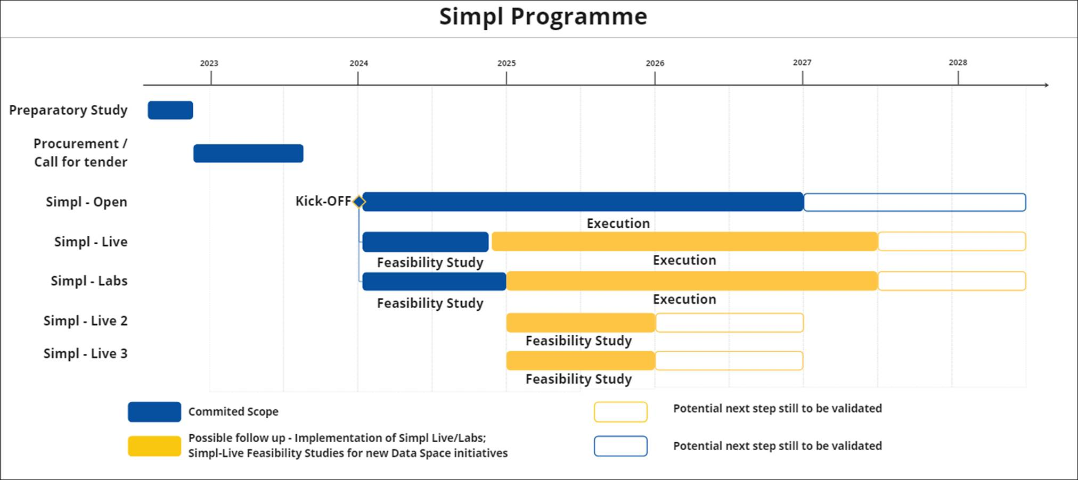
The programme 2024 onwards

Slide 20
Save the date: 30 January 2025, Brussels
First yearly event
Live demo of the Minimum Viable Product for Simpl-Open
Live demo of the Proof of Concept for Simpl-Labs
Roadmaps for the 6x Simpl-Live deployments
Fun!
Registration to come

Slide 21
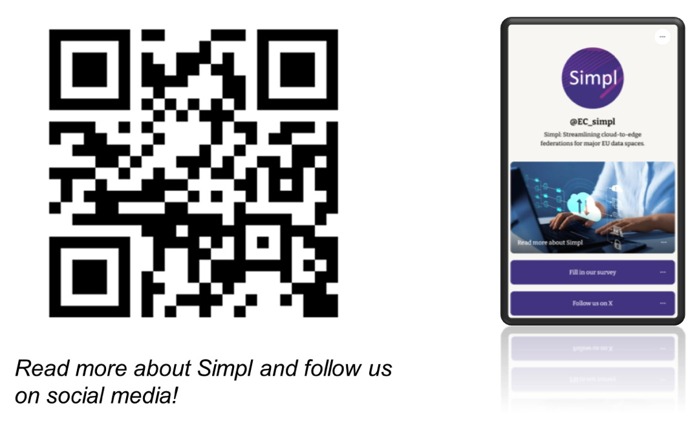
Engage with Simpl

Slide 22
Simpl
Continuous requirements gathering

Slide 23
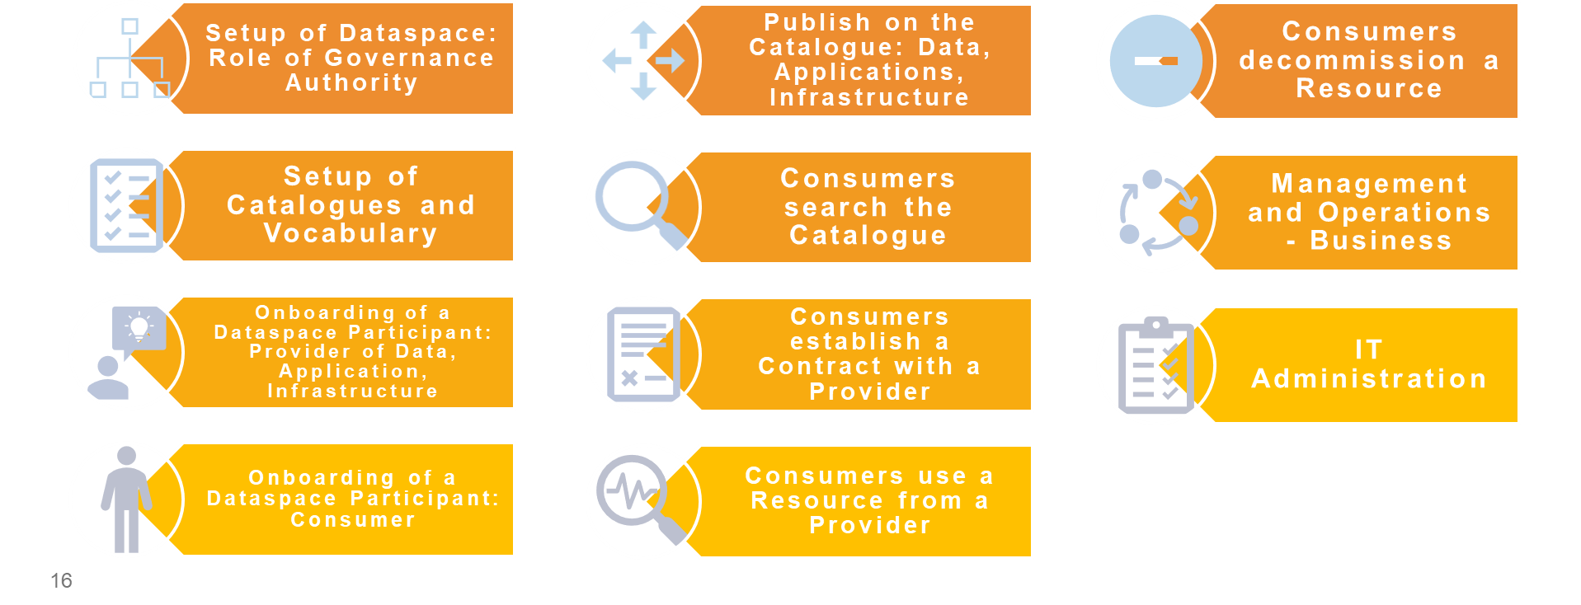
Supported Business Processes

Slide 24
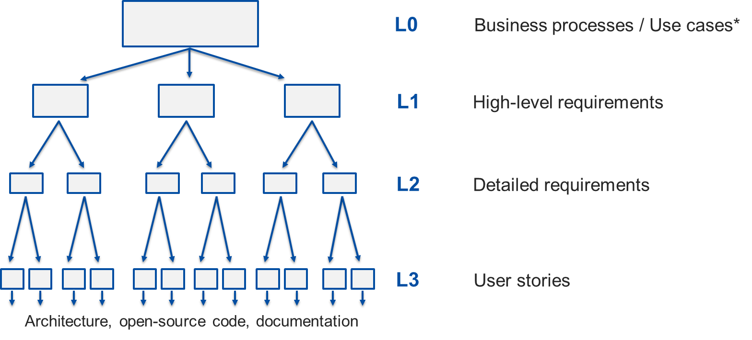
Agile Requirements Elicitation
Requirements Identification
Requirements Elaboration
Requirements Validation
Requirements Feedback Cycle

Slide 25
State-of-play
Proof of Concept (PoC)
  Done!
  2 sprints behind us (May and June)
  Onboarding of a (data, applications, or infrastructure) provider
  Publishing on the resource catalogue (of data, applications, or infrastructure)
Minimum Viable Product (MVP)
  Scope stabilised!

Slide 26
Onboarding of a Provider - summary
Before a provider of data, applications, or infrastructure can participate in a dataspace, they must be formally onboarded
The Dataspace Governance Authority will have set the rules that the providers must fulfil to be onboarded
  E.g. which documents to provide, security to set up

Slide 27
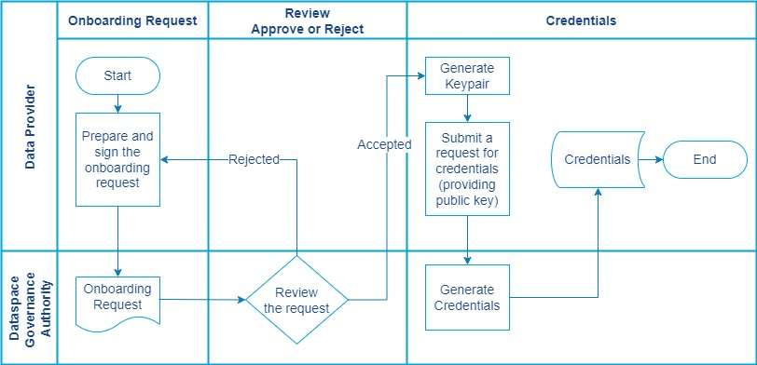
Onboarding of a Provider – main steps

Slide 28
Publishing on the Catalogue - summary
Providers can publish resources on the dataspace catalogue
Resources can be:
    Datasets
    Applications
    Infrastructure
Resources published on the catalogue are discoverable by consumers

Slide 29
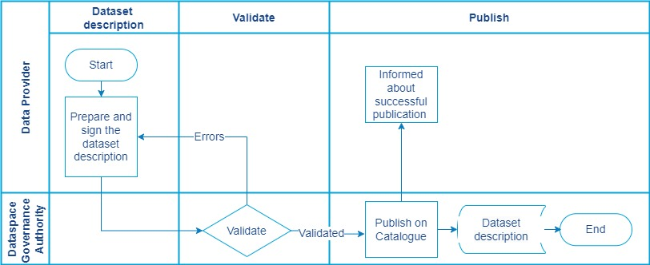
Publishing on the Catalogue – main steps

Slide 30
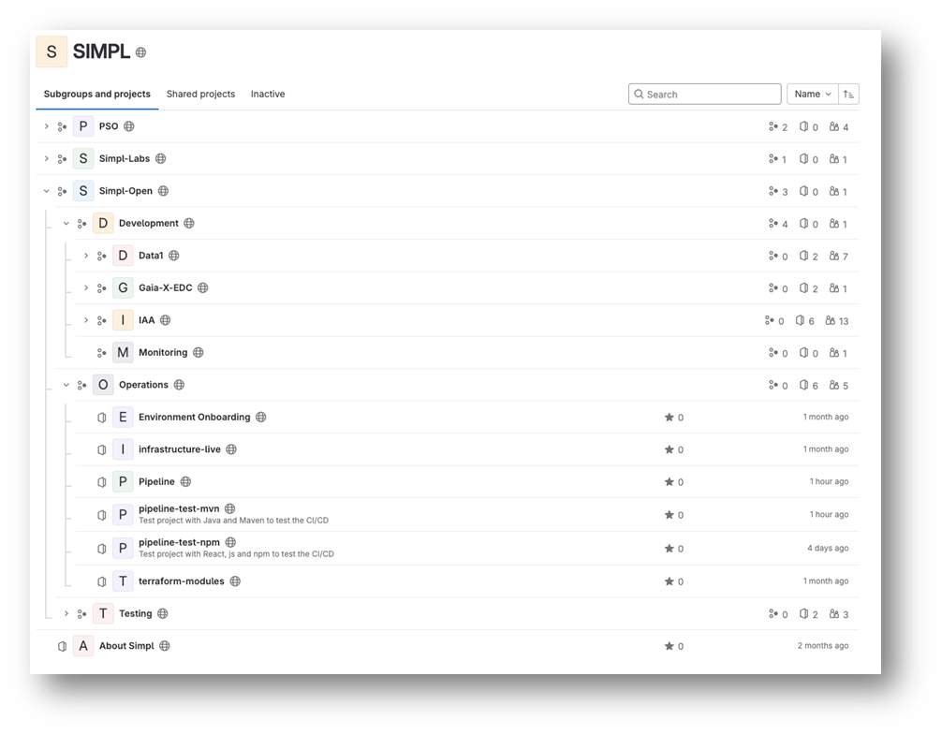

Simpl is Open Source
https://code.europa.eu/simpl

Slide 31
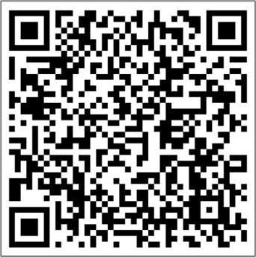
Q&A
Subscribe to the DSSC Newsletter!

